Slide 1
Egyptian Period

Slide 2
Egyptian 3100 b.c.- 30 b.c.
Egyptian Art has a big focus on the afterlife. This time period also reached a high level of art in painting and sculpting and their art became very symbolic as the course of this time period went on.
Many piece of art were found in tombs and monuments, emphasizing the effect of art focus on the afterlife.

Slide 3
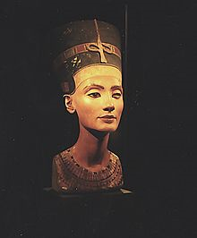
Art Depicting People
Many people praise art from this time period because of their advancements in creating artwork that shows the human figure. In art of the past, we have talked about how it is hard to really tell how they look because of the way they were drawn or sculpted. However, in this Egyptian time period, artworks of people are very realistic and give a very clear view of how they may have looked.

Slide 4
Bust of Nefertiti
This is a bust of the pharaoh's wife and was made from limestone. Since its discovery, it has become a symbol for this time period.

Slide 5
Palette of Narmer
Said to be a depiction of the Upper and Lower region of Egypt under the rule of King Narmer
Known as the “first historical document”
There is a big debate on if the plate shows actual events or if it is hitting on mythology
It was found in 1897 by archeologists in the Temple of Horus

Slide 7
Step Pyramid
This pyramid in Egypt is one of the first known uses of blocks to build with.
Regular buildings of this time were created by mud-brick, however for this tomb structure to be dynamic, they knew they needed to create something more sturdy.
The steps are said to symbolize re-birth for the king after they pass away.
The pyramid was designed with such a big structure for room for future dynasty leaders

Slide 9
The Great Pyramids
Similar to the step pyramid, the Great Pyramids were designed to be a tomb for the pharaoh. They thought that the pharaoh would also be king of the afterlife. This is why they would bury him with so many items.
There are many mysteries surrounding how they built these pyramids. Much like Stonehenge, these pyramids are built from heavy materials that would have been difficult to transport.

Slide 11
